Slide 1
Data Analytics Capstone Project
History of Data Breaches in U.S
Presented by
Miriam Rodriguez

Slide 2
Project Overview and Business Purpose
The business purpose was to investigate the history of data breaches in the U.S using Data Science techniques to gather information about data breaches, their impact and trends.
A dataset from an external website was provided for that purpose
Utilized techniques to perform data transformation, cleaning and integration
Performed exploratory data analysis and data visualization to gather insights and answer questions.
Determine the best data model to use for prediction
Explored different data models by building models
Evaluated the performance of each model.
Models were built using unsupervised (topic modeling) and supervised (classification) machine learning techniques.
Final analysis and story telling:
Interpretation of model outputs
Answer business questions
Managerial and technical implications

Slide 3
Data Description and Understanding
Dataset name: Privacy_Rights_Clearinghouse-Data-Breaches-Export.csv
Source: https://www.privacyrights.org/data-breaches (Links to an external site.).
Data Description and FAQ: https://www.privacyrights.org/chronology-data-breaches-faq
Duration of the data: 2005 through 2017

Slide 4
Data Description and Understanding
Data elements/column names
Date Made Public: Date Breach information released to public (date: year, month, day)
Company: Company breached (text)
City: City of breached company (text)
State: State of breached company (text)
Type of Breach: Four-character Breach Type
Type of Organization: Three-character Organization Type
Total Records: Number of records breached (integer)
Description of Incident: Text describing breach (text)
Information Source: Location of database source (text)
Source URL: Location of data source URL (text)
Year of Breach: Four digit year (numeric)
Latitude: Location Latitude (signed numeric long)
Longitude: Location Longitude (signed numeric long)

Slide 5
Data Description and Understanding
Data Breach Types
CARD - Payment Card Fraud: Fraud involving debit and credit cards that is not accomplished via hacking (e.g. skimming devices at point-of-service terminals).
HACK - Hacking or Malware: Hacked by outside party or infected by malware
INSD - Insider: Someone with legitimate access intentionally breaches information, such as an employee, contractor, or customer)
PHYS - Physical Loss: Includes paper documents that are lost, discarded, or stolen (non-electronic)
PORT - Portable Device: Lost, discarded, or stolen laptop, PDA, smartphone, memory stick, CDs, hard drive, data tape, etc.
STAT - Stationary Device: Stationary computer loss (lost, inappropriately accessed, discarded, or stolen computer or server not designed for mobility)
DISC - Unintended Disclosure: Unintended disclosure (not involving hacking, intentional breach, or physical loss i.e. sensitive information posted publicly, mishandled, sent to the wrong party via publishing online, sending in an email, sending in a mailing or sending via fax.
Unknown

Slide 6
Data Description and Understanding
Institution/Organization) Type
BSF - Businesses - Financial and Insurance Services
BSO - Businesses - Other
BSR - Businesses - Retail/Merchant – Including Online Retail
EDU - Educational Institutions
GOV - Government & Military
MED - Healthcare - Medical Providers & Medical Insurance Services
NGO - Nonprofit Organizations

Slide 7
Data assessment, Transformation, Cleaning / Integration
There are 8202 records total.
Checked data information and determined there were data quality issues:
Date Made Public 8202 non-null object
Company 8202 non-null object
City 5682 non-null object
State 8134 non-null object
Type of breach 8202 non-null object
Type of organization 8202 non-null object
Total Records 8164 non-null object
Description of incident 8199 non-null object
Information Source 8148 non-null object
Source URL 2792 non-null object
Year of Breach 8169 non-null float64
Latitude 8202 non-null float64
Longitude 8202 non-null float64
Based upon above counts, there are missing values for City, State, Total Records, Description, Breach Year

Slide 8
Data Assessment, Transformation, Cleaning / Integration
Data Cleaning
Column name: City
How resolved: Drop column.
Justification: The majority of cities are not provided. All we really need is State.
Column name: State
How resolved: Replace spaces with 'United States'
Justification: Since this value was not provided in the file, the assumption is that the breach was national.
Column name: Total Records
How resolved: Move zeros to null values. Then convert to float to remove zeros, then convert to int.
Justification: This will enable the ability to measure the quantitative impact.
Column name: Description
How resolved: Replace spaces with 'None'
Justification: This value was not provided in the file.
Column name: Breach Year
How resolved: Drop column
Justification: We have date with year with no empty values so do not need this field
Remove the following fields as they are not needed:
Information Source
Source URL

Slide 9
Data Assessment, Transformation, Cleaning / Integration
Created new columns with assigned numerical values so that these would be picked up by histograms and correlations. Added _CAT to column names.
Breach Type
Organization Type
State
Converted values of all numerical columns to integers
Removed all non-US states from file. Total records reduced to 8177
Renamed several columns
Converted Date of Breach to Year only so now it becomes Breach Year replacing the one dropped. It had values in every record where the original one did not.
Integrated GDP from another file for normalization
Created new file for just longitude and latitude columns and removed them from the breach file.
Wrote cleaned breach file.

Slide 10
Exploratory Data Analysis and Data Visualization
Basic Statistics and Visualization
‘Describe’ for columns with object types will provide statistical results as follows:
Breach Year:
count 8177
unique 14
Top 2014
freq 887
The largest number of breaches occurred in 2014.
There are 14 years
Total record count is 8,177

Slide 11
Exploratory Data Analysis and Data Visualization
Basic Statistics and Visualization
In order to answer business questions, need certain statistics:
To get counts: Statistical commands such as ‘df.groupby(['Breach_Year']).size()’ will provide counts for each group within a column.
Did this for Breach Type, Organization Type and State.
Created Histograms for each numerical column
(histograms in next slide)

Slide 12
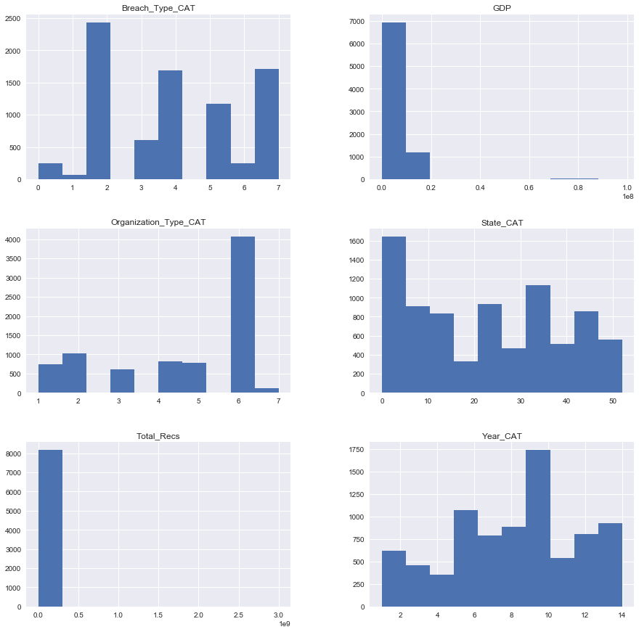
Exploratory Data Analysis and Data Visualization
Basic Statistics and Visualization

Slide 13
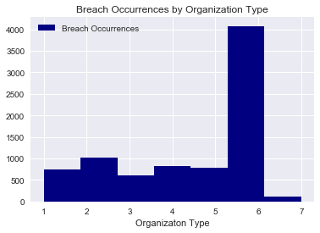
Exploratory Data Analysis and Data Visualization
Basic Statistics and Visualization- Organization Types
Legend for Organization Types:
1 BSF - Businesses - Financial and Insurance Services
2 BSO - Businesses - Other
3 BSR - Businesses - Retail/Merchant – Including Online Retail
4 EDU - Educational Institutions
5 GOV - Government & Military
6 MED - Healthcare - Medical Providers & Medical Insurance Services
7 NGO - Nonprofit Organizations
Shows Medical has the largest number of breaches
Counts by category
1 - 746
2 -1028
3 -615
4 - 818
5 - 775
6 - 4077
7 - 118

Slide 14
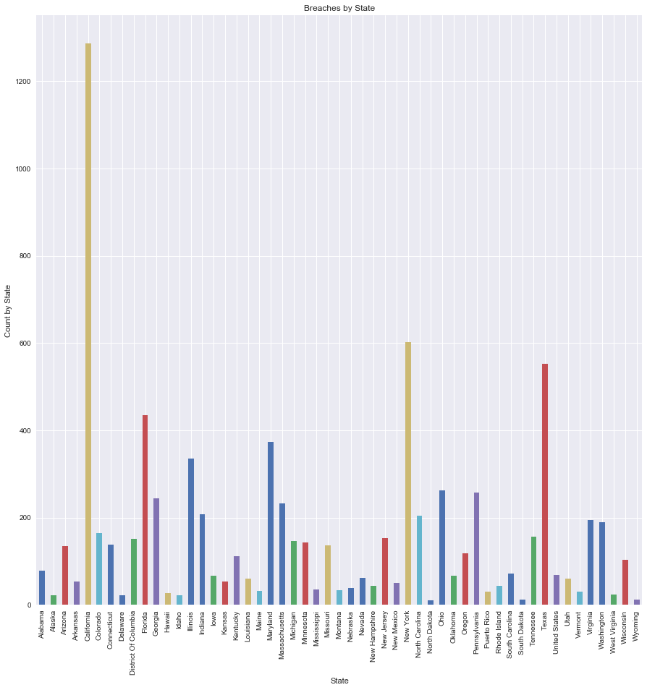
Exploratory Data Analysis and Data Visualization
Basic Statistics and Visualization- State CA top breaches

Slide 15
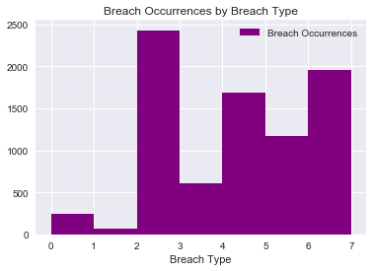
Exploratory Data Analysis and Data Visualization
Basic Statistics and Visualization- Breach Types
Legend for Breach Types:
1: CARD - Payment Card Fraud:
2: HACK - Hacking or Malware
3: INSD – Insider
4: PHYS - Physical Loss
5: PORT - Portable Device
6: STAT - Stationary Device
7: DISC - Unintended Disclosure
0: Unknown
Top Breach Type is ‘HACK’
Counts:
CARD 68
DISC 1708
HACK 2431
INSD 609
PHYS 1691
PORT 1172
STAT 249
UNKN 249

Slide 16
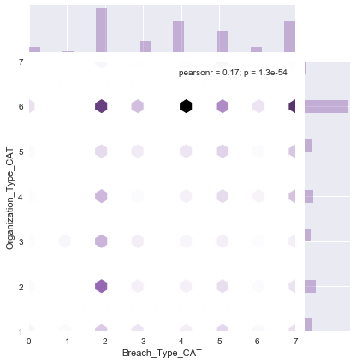
Exploratory Data Analysis and Data Visualization
Basic Statistics and Visualization- Breach X Organization Types
Organizations Y
1 BSF - Businesses - Financial and Insurance Services
2 BSO - Businesses - Other
3 BSR - Businesses - Retail/Merchant –
Including Online Retail
4 EDU - Educational Institutions
5 GOV - Government & Military
6 MED - Healthcare
7 NGO - Nonprofit Organizations
Breach X
1: CARD - Payment Card Fraud:
2: HACK - Hacking or Malware
3: INSD – Insider
4: PHYS - Physical Loss
5: PORT - Portable Device
6: STAT - Stationary Device
7: DISC - Unintended Disclosure
0: Unknown
Shows Medical with the most breaches, Especially Hacking and Physical Loss

Slide 17
Exploratory Data Analysis and Data Visualization
Basic Statistics and Visualization- Correlation Breach Types
Total_Recs Unknown CreditCard Hacking Insider Physical \
Total_Recs 1.000000 -0.002099 -0.002658 0.031210 -0.008220 -0.016264
Unknown -0.002099 1.000000 -0.016229 -0.115273 -0.050273 -0.090490
CreditCard-0.002658 -0.016229 1.000000 -0.059564 -0.025977 -0.046758
Hacking 0.031210 -0.115273 -0.059564 1.000000 -0.184513 -0.332118
Insider -0.008220 -0.050273 -0.025977 -0.184513 1.000000 -0.144844
Physical -0.016264 -0.090490 -0.046758 -0.332118 -0.144844 1.000000
Portable -0.011633 -0.072490 -0.037457 -0.266054 -0.116032 -0.208854
Stationary-0.005458 -0.031408 -0.016229 -0.115273 -0.050273 -0.090490
Disclosure 0.000237 -0.091063 -0.047054 -0.334222 -0.145762 -0.262367
There is a negative correlation between Hacking and Disclosure and Hacking and Physical.

Slide 18
Model Building and Evaluation – Approach Taken
Looked at a variety of modeling algorithms:
Unsupervised machine learning
Supervised machine learning - Classification
Linear regression and Logistic regression
Ran data through each model
Scored each model
Evaluated, adjusted and determined which model fit the data the best.
Used the selected models in order to answer business questions.

Slide 19
Model Building and Evaluation
Supervised Classification Modeling – Incident Descriptions
Used Breach Type as Classifier
This is a multi-class classification (8 types)
Preprocessed and used feature engineering
(Words to Vectors)
Models Built
Validation using Split Validation 70/30
Grid Search
Cross Validation
Evaluation (scoring)

Slide 20
Model Building and Evaluation
Classification Report for Naïve Bayes
precision recall f1-score support
CARD 0.00 0.00 0.00 18
DISC 0.78 0.30 0.43 504
HACK 0.59 0.93 0.72 746
INSD 0.83 0.21 0.34 165
PHYS 0.61 0.80 0.69 523
PORT 0.77 0.75 0.76 351
STAT 0.00 0.00 0.00 73
UNKN 0.00 0.00 0.00 74
avg/total
0.63 0.64 0.59 2454

Slide 21
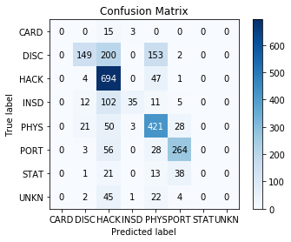
Model Building and Evaluation
Naïve Bayes Confusion Matrix
Overall accuracy = 0.636919315403
Highest accuracy shows 'Hack' with 694 correct classifications
Next highest is 'Phys' with 421 correct classifications, then 'PORT' with 264.
200 were miscalculated as Hack when they should have been DISC. 153 were miscategorized as 'PHYS' when should be 'DISC'.

Slide 22
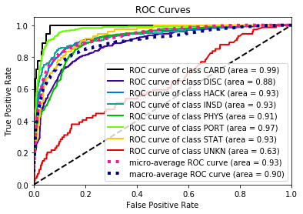
Model Building and Evaluation - Naïve Bayes – ROC Curve
Explanation of the ROC Curves: The steeper the curve the more accurate it is.
The highest accuracy is shown by the CARD breach type, followed by PORT.
The lowest accuracy is shown by the UNKN breach type.
This is a better model than shown by the confusion matrix.

Slide 23
Model Building and Evaluation
Fit Data to SVM model/Classification Report
precision recall f1-score support
CARD 0.67 0.44 0.53 18
DISC 0.71 0.70 0.71 504
HACK 0.83 0.87 0.85 746
INSD 0.84 0.77 0.80 165
PHYS 0.74 0.82 0.78 523
PORT 0.84 0.90 0.87 351
STAT 0.73 0.52 0.61 73
UNKN 0.67 0.05 0.10 74
avg/total
0.78 0.78 0.77 2454

Slide 24
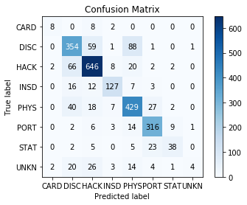
Model Building and Evaluation - SVM Confusion Matrix
Overall accuracy = 0.783211083945
Highest accuracy shows 'Hack' with 646 correct classifications
Next highest is 'Phys' with 429 correct classifications, then 'DISC' with 354 and PORT with 316.

Slide 25
Model Building and Evaluation
Fit Data to Random Forest model / Classification Report
precision recall f1-score support
CARD 1.00 1.00 1.00 18
DISC 0.88 0.88 0.88 504
HACK 0.97 0.94 0.96 746
INSD 1.00 0.99 1.00 165
PHYS 0.89 0.96 0.92 523
PORT 1.00 1.00 1.00 351
STAT 1.00 1.00 1.00 73
UNKN 1.00 0.77 0.87 74
avg/total
0.94 0.94 0.94 2454

Slide 26
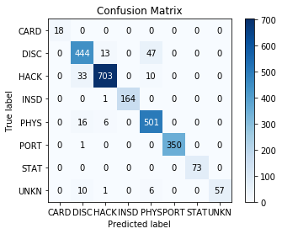
Model Building and Evaluation –
Random Forest Confusion Matrix
Overall accuracy .941320293399
CARD, STAT at 1.0 accuracy
PORT - 350 correctly predicted, 01 miscategorized as DISC
INSD - 164 correctly predicted, 01 miscategorized as HACK
PHYS - 501 correctly predicted, 06 miscategorized as HACK, 16 miscategorized as DISC
HACK - 703 correctly predicted, 33 miscategorized as DISC, 10 miscategorized as PHYS
DISC - 444 correctly predicted, 13 miscategorized as HACK, 47 miscategorized as PHYS
UNKN - 057 correctly predicted, 01 miscategorized as HACK, 10 miscategorized as DISC

Slide 27
Model Building and Evaluation
Supervised Classification Modeling – Incident Descriptions
Naive Bayes Multinomial
kNeighbors Classifier (kNN)
SVM (Support Vector Machine)
Random Forest
0.63691931540342295
0.68052159739201301
0.783211083945
0.94132029339853296
Models
Overall Accuracy

Slide 28
Model Building and Evaluation
Supervised Classification Models – Adjustments to Improve
Naive Bayes Multinomial
Removed Stop Words
After Grid Search-no adjust
Cross-Validation 10 fold
After Grid Search – new parameters
kNeighbors Classifier (kNN)
Not able to improve
SVM (Support Vector Machine)
Not able to improve
Random Forest (Selected)
0.66462917685411571
0.72290138549307248
0.717871168729
0.68581907090464544
0.68052159739201301
0.783211083945
0.94132029339853296
Models
Overall Accuracy

Slide 29
Model Building and Evaluation -Supervised Classification
(non-text features) Breach Types
This is a multi-class classification
Data Preparation (Remove stop words and unimportant columns)
Model building and Validation
Decision Tree Model (Observation - Adjusting the max depth to 6 and min samples to 45, improved accuracy of model)
Logistic and Logit Regression
K-nearest Neighbors (knn) Using Grid Search
Random Forest
Split Validation 30/70
Cross Evaluation
Model Evaluation

Slide 30
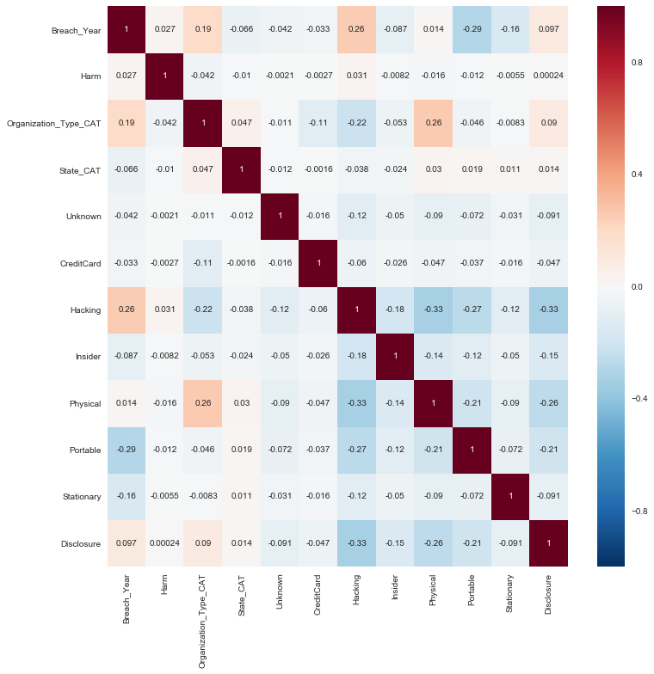
Model Building and Evaluation -Supervised Classification
(non-text ) Breach Types - Correlation with Other features

Slide 31
Model Building and Evaluation -Supervised Classification
(non-text) Breach Type - Correlation with Other Features
What are the findings from correlation analysis?
The higher values seem to occur with hacking breaches.
Hacking and all other breach types show a negative correlation.
Physical breaches are also among the higher scores.
For the most part the correlation scores appear to be low.

Slide 32
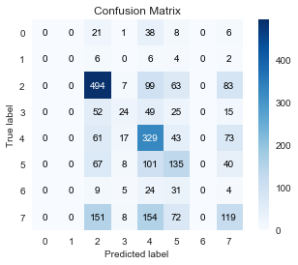
Model Building and Evaluation -Supervised Classification
(non-text features) Breach Types – Decision Tree
Decision Tree Model not a good fit at .45
Overall accuracy .448655256724
The decision tree model went from 40% to 45% accurate when adjusting the depth and number of leaves. Therefore, we expect that the model will be about 45% accurate when the model is applied into a real-world situation
Hacking is showing the most accurate prediction of all at 494.
Overall accuracy calculated as correctly classified 2454 total in test dsn = 45%

Slide 33
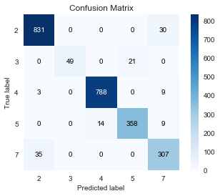
Model Building and Evaluation -Supervised Classification
(non-text features) Breach Types – Decision Tree
Created Scoring dataset by removing Breach Type from dataset (Y)
Fit scoring data to Decision Tree model and created ‘Predicted Y’
Reduced sample size from 45 to 5. With these features showing 95% accurate,
Overall accuracy = 0.950692746536
Showing these features as the best predictors:
2: HACK - Hacking
3: INSD - Insider:
4: PHYS - Physical Loss:
5: PORT - Portable Device
7: DISC - Unintended Disclosure:
Physical loss being the most accurate and hacking the least.

Slide 34
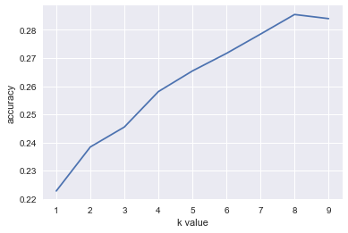
Model Building and Evaluation -Supervised Classification (non-text) Breach Type K-nearest Neighbors (knn) Using Grid Search Results
Optimal K-Value = 8,
overall accuracy 0.334148329258

Slide 35
Model Building and Evaluation -Supervised Classification
(non-text) Breach Type
Cross Evaluation- knn Results
[ 0.29539952 0.18401937 0.26876513 0.27118644 0.24697337 0.28329298 0.29297821 0.2590799 0.27007299 0.24264706 0.31127451 0.26108374 0.2962963 0.27160494 0.2691358 0.27407407 0.29382716 0.26419753 0.34814815 0.31111111]
Overall accuracy 0.275758414108
Not the best model to use
SelectKBest, Extra Tree Classifier, RFE also not good to use.
Logistic and Logit Regression Results
Split Validation into Training and Test datasets
Overall accuracy 0.303993480033
Not a good model to use
Logit does not work for multi-class features.

Slide 36
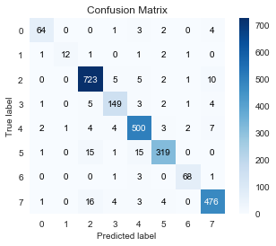
Model Building and Evaluation -Supervised Classification
(non-text) Breach Type – Random Forest
Overall accuracy = 0.94132029339853296
Hacking showing largest population
Best model to use for classification

Slide 37
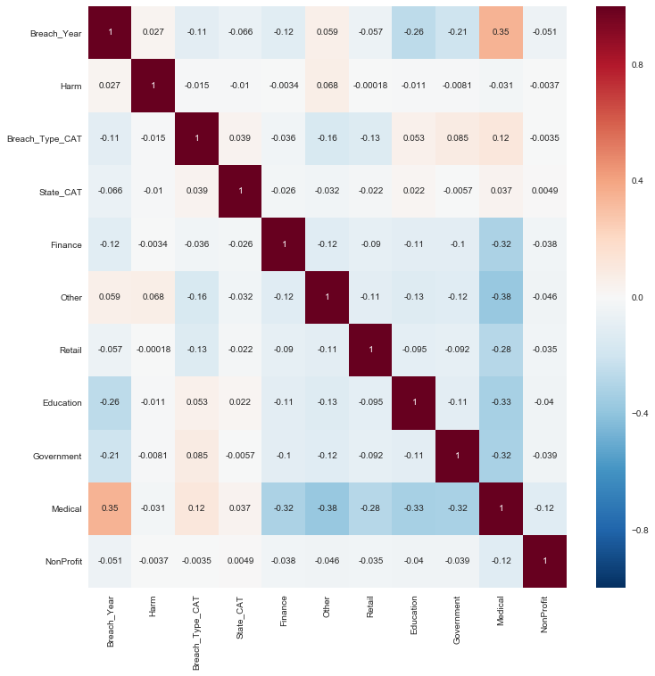
Model Building and Evaluation -Supervised Classification
(non-text ) Organization Types - Correlation with Other features

Slide 38
Model Building and Evaluation -Supervised Classification
(non-text) Organization Type – Findings and Summary
What are the findings from correlation analysis?
The higher values seem to occur with medical and harm.
Retail and medical have a negative correlation.
Medical has a positive correlation with the other organizations.
For the most part the correlation scores appear to be low.
Summary
Medical Organizations predicted the most often
Tested same models as Breach Types with similar results
Random Forest best model to use at overall accuracy of .90.

Slide 39
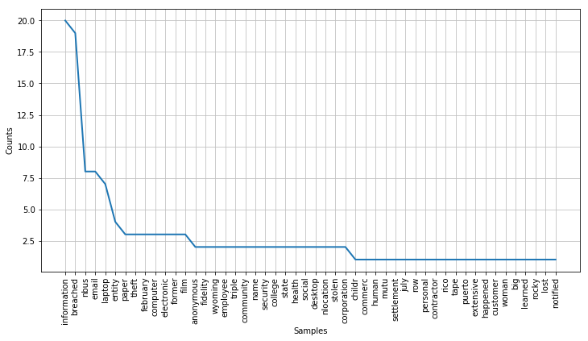
Model Building and Evaluation –Unsupervised Machine Learning
Text Data Preprocessing and Results
Conducted word frequency analysis

Slide 40
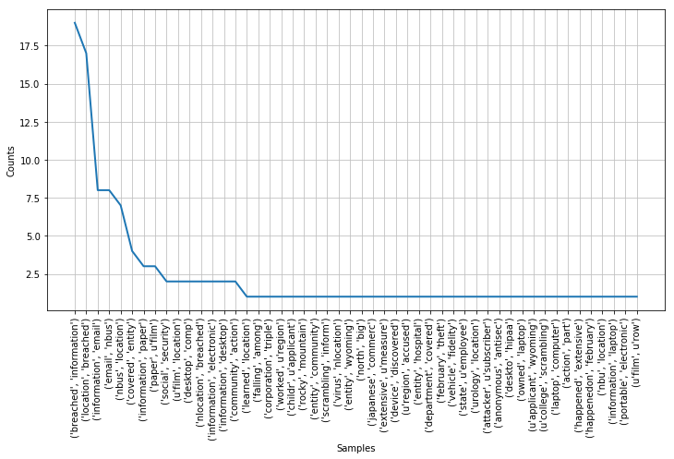
Model Building and Evaluation –Unsupervised Machine Learning
Text Data Preprocessing and Results
Conducted word frequency analysis - Bigrams

Slide 41
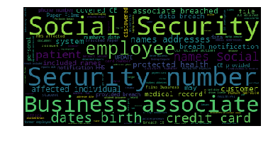
Model Building and Evaluation -Unsupervised Machine Language
Word Cloud
The themes here appear to be social security number, credit cards, birthdates, names and addresses, employees and business associates

Slide 42
Model Building and Evaluation -Unsupervised Machine Learning
LDA Topic Modeling – Top Topics
Used 10 for the number of topics.
Used pyLDAvis to generate a Intertopic Distance Map.
Assigned the topics to the documents in corpus (Document-Topic Distribution)
Top 10 topics represent all breach types.

Slide 43
Model Building and Evaluation -Unsupervised Machine Learning
LDA Topic Modeling – Top Topics
Top 10 Topics
- 1) Hacking - getting email, passwords, etc.
u'0.026*"employe" + 0.026*"hacker" + 0.022*"access" + 0.017*"ident"
- 2) Portable - Stolen laptop from employee containing patient medical information, birthdate, etc.
u'0.036*"patient" + 0.032*"social" + 0.026*"contain" + 0.025*"employe" + 0.024*"date" + 0.023*"laptop" + 0.023*"stolen"
- 3) Unknown - Companies, employee or employer updating state data and notifying million. Could be a disclosure.
u'0.034*"data" + 0.032*"compani" + 0.021*"employe" + 0.021*"updat" + 0.017*"state"
- 4) Stationary - Health report on laptop and desktop, associated with government
u'0.078*"health" + 0.073*"report" + 0.072*"servic" + 0.067*"human" + 0.041*"electron" + 0.035*"laptop"
- 5) Disclosure - Email sent to wrong people
u'0.042*"mail" + 0.035*"sent" + 0.025*"email" + 0.023*"employe" + 0.021*"address"
- 6) Credit Card - Credit card information through payment systems
u'0.087*"card" + 0.058*"credit" + 0.052*"custom" + 0.022*"payment" + 0.017*"system" + 0.013*"may" + 0.012*"debit" + 0.011*"bank" + 0.011*"store"
- 7) Insider - Associate/Individual provided protected health information
u'0.030*"individu" + 0.022*"health" + 0.021*"ocr" + 0.020*"associ" + 0.020*"provid" + 0.019*"phi" + 0.019*"protect"
- 8) Hacking - Unauthorized access to email account
u'0.029*"access" + 0.023*"account" + 0.022*"address" + 0.022*"email" + 0.018*"may" + 0.015*"includ" + 0.015*"investig"
- 9) Insider - breach using university computer hard drive by former university student through social media
u'0.055*"student" + 0.038*"social" + 0.036*"univers" + 0.033*"drive" + 0.029*"comput" + 0.022*"person + 0.018*"former"
- 10) Physical - breach relating to film or paper located by associate
u'0.173*"associ" + 0.150*"present" + 0.148*"nbusi" + 0.104*"locat" + 0.065*"nlocat" + 0.038*"paper" + 0.035*"server" + 0.033*"film"

Slide 44
Model Building and Evaluation -Unsupervised Machine Learning
Top Topics from LSI Model “Latent Semantic Indexing”
Similar to LDA only in different order and less clear
1) Breaches relating to business and servers.
2) Stolen laptop from employee containing patient medical information.
3) Breaches related to email
LSI shows topics that appear similar, but harder to differentiate topics in this case.
Prefer LDA topic model.

Slide 45
Model Building and Evaluation
Conclusion
For unsupervised topic modeling, LDA is best.
For all supervised classification models for description data, Random Forest is the best.

Slide 46
Final Analysis and Insights
Answer Business Questions
Interpretation of model outputs
Managerial and technical implications

Slide 47
Final Analysis and Insights - Answer Business Questions
What types of data breaches are more popular than others or which data breach type is most popular?
In terms of the number of incidents, out of 8177 incidents, 2,431 were caused by hacking.
count 8177 , unique 8 , top HACK , freq 2431

Slide 48
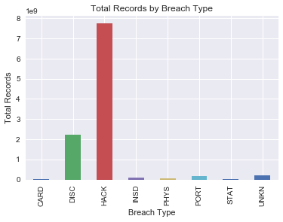
Final Analysis and Insights - Answer Business Questions
What types of data breaches are more popular than others or which data breach type is most popular?
In terms of the number of total records, hacking caused the greatest degree of harm compared to all other causes.

Slide 49
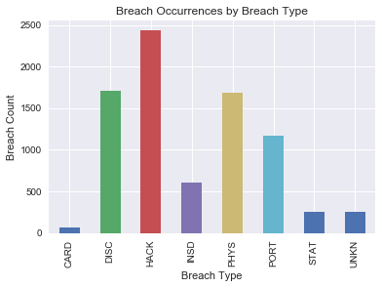
Final Analysis and Insights - Answer Business Questions
What are the three main causes of data breach?
Comparison of the results reveal the top three causes are Hacking, Disclosure, and Physical Theft

Slide 50
Final Analysis and Insights - Answer Business Questions
What types of organizations are more likely to have a data breach?
Medical is most likely to have a breach
Which organization type has the highest number of data breaches?
In terms of the number of incidents, healthcare (MED) organizations had the highest number of data breaches.
1 BSF - Businesses - Financial and Insurance Services
2 BSO - Businesses - Other
3 BSR - Businesses - Retail/Merchant – Including Online Retail
4 EDU - Educational Institutions
5 GOV - Government & Military
6 MED - Healthcare - Medical Providers & Medical Insurance Services
7 NGO - Nonprofit Organizations

Slide 51
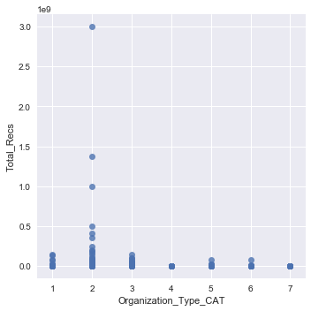
Final Analysis and Insights - Answer Business Questions
Which organization type has the highest number of data breaches?
In terms of the number of total records affected, businesses categorized as other (BSO) were the hardest hit.
1 BSF - Businesses - Financial and Insurance Services
2 BSO - Businesses - Other
3 BSR - Businesses - Retail/Merchant – Including Online Retail
4 EDU - Educational Institutions
5 GOV - Government & Military
6 MED - Healthcare - Medical Providers & Medical Insurance Services
7 NGO - Nonprofit Organizations

Slide 52
Final Analysis and Insights - Answer Business Questions
Which organization types appear to be the target of data breaches?
The biggest target appears to be healthcare, followed by other businesses. The next targets in order are educational, government, financial services, retail (including online) and least non-government organizations.
1 BSF - Businesses - Financial and Insurance Services
2 BSO - Businesses - Other
3 BSR - Businesses - Retail/Merchant – Including Online Retail
4 EDU - Educational Institutions
5 GOV - Government & Military
6 MED - Healthcare - Medical Providers & Medical Insurance Services
7 NGO - Nonprofit Organizations

Slide 53
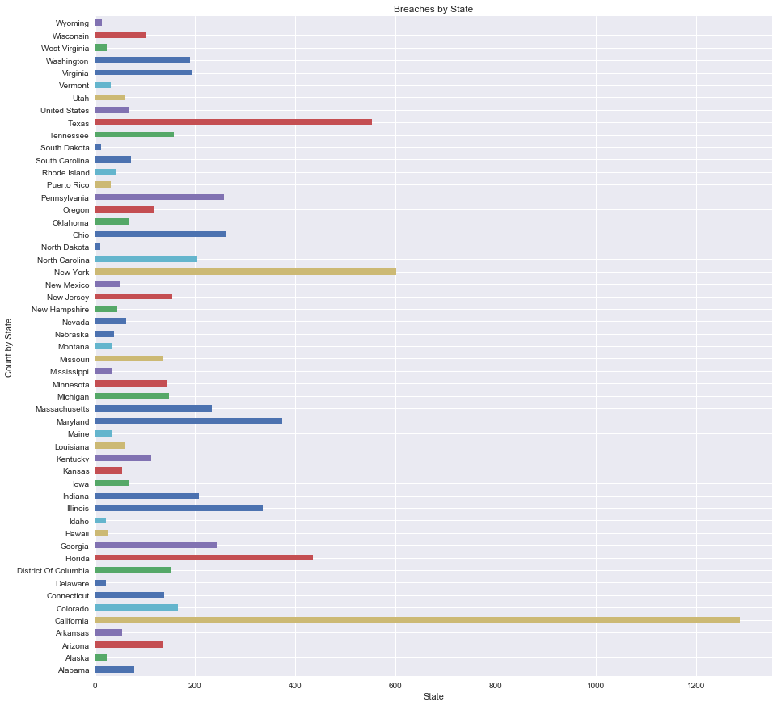
Final Analysis and Insights - States and Data Breaches
Which US states are more likely to have data breaches?
Florida, Texas, California and New York seem to be targets for data breaches.

Slide 54
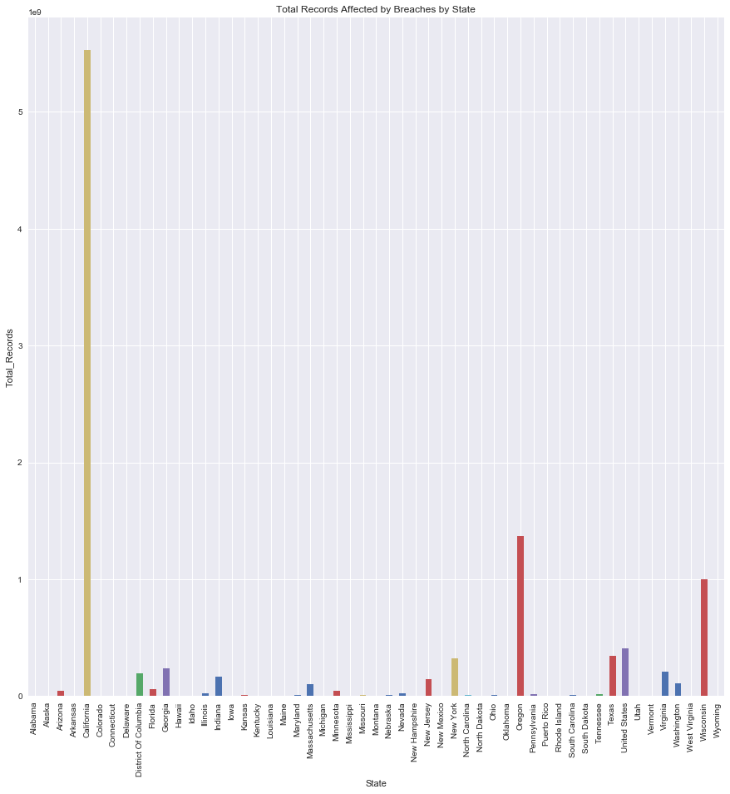
Final Analysis and Insights - Answer Business Questions
States and Data Breaches
Which US states are more likely to have data breaches?
In terms of harm (total records), California, Wisconsin and Oregon are the top states.

Slide 55
Final Analysis and Insights - States and Data Breaches
Which US states are less likely to have data breaches?
Based on past years, it appears that North and South Dakota and Wyoming have the least chance of data breaches.

Slide 56
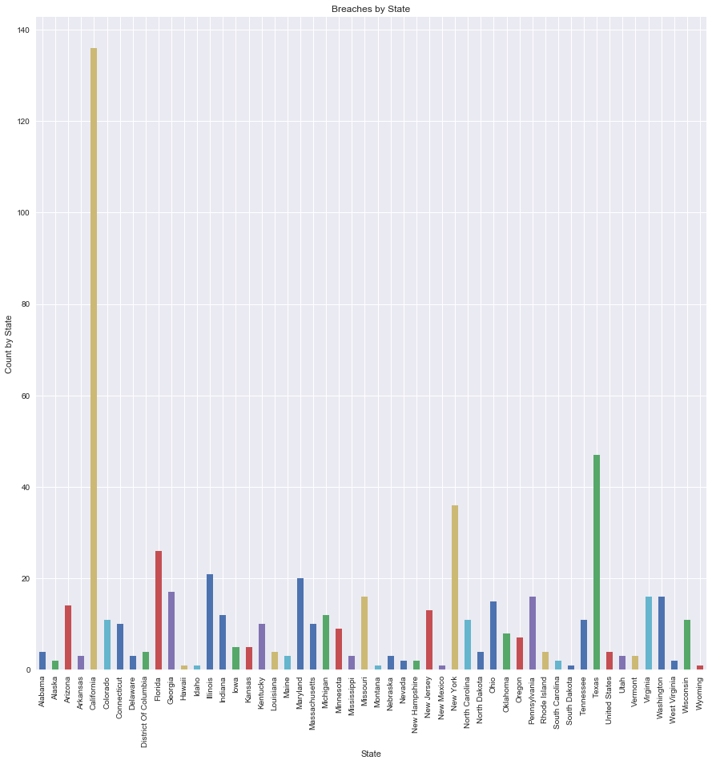
Final Analysis and Insights - States and Data Breaches 2017
What are the top three states in terms of the number of data breaches in 2017?
California, New York and Texas are the top three states in 2017.

Slide 57
Final Analysis and Insights – Business Questions
Organizations and Data breaches
Which organization type is more vulnerable to “Hackers”?
The organization type most vulnerable to 'Hackers' is healthcare (MED).
Breach Type == 'HACK‘
Organization Type
BSF 210
BSO 602
BSR 298
EDU 288
GOV 147
MED 848
NGO 38

Slide 58
Final Analysis and Insights – Business Questions
Organizations and Data breaches
What is the most popular data breach type for education?
The most popular breach type for education was hacking.
Organization Type = ‘EDU’
CARD 1
DISC 238
HACK 288
INSD 26
PHYS 61
PORT 138
STAT 48
UNKN 18

Slide 59
Final Analysis and Insights – Business Questions
Organizations and Data breaches
Which state is more vulnerable to “Hackers”?
California is the most vulnerable to hackers.
count 2431 Total Hack breaches
unique 53
top California
freq 461 Number of Hack breaches for CA

Slide 60
Final Analysis and Insights – Business Questions
Organizations and Data breaches
Which state is more vulnerable to “Hackers”?
California is the most vulnerable to hackers.
count 2431 Total Hack breaches
unique 53
top California
freq 461 Number of Hack breaches for CA
Which state is more vulnerable to “Card”?
California is the most vulnerable to Credit Card breaches.
count 68 Total Card breaches
unique 25
top California
freq 13 Number of Card breaches for CA

Slide 61
Final Analysis and Insights – Business Questions
Organizations, Data Breaches and Time 2005-2017
How many breaches per year?
Breach Year
2005 136
2006 482
2007 454
2008 355
2009 271
2010 801
2011 788
2012 882
2013 852
2014 887
2015 539
2016 804
2017 602

Slide 62
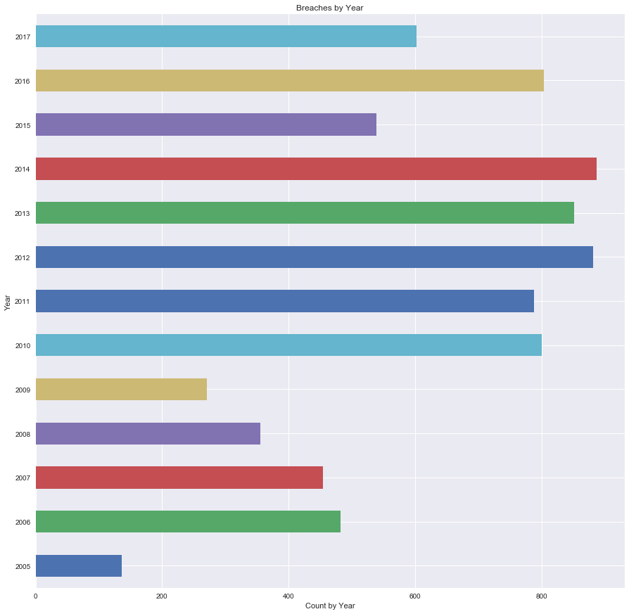
Final Analysis and Insights Organizations, Data Breaches and Time 2005-2017
How many breaches per year?

Slide 63
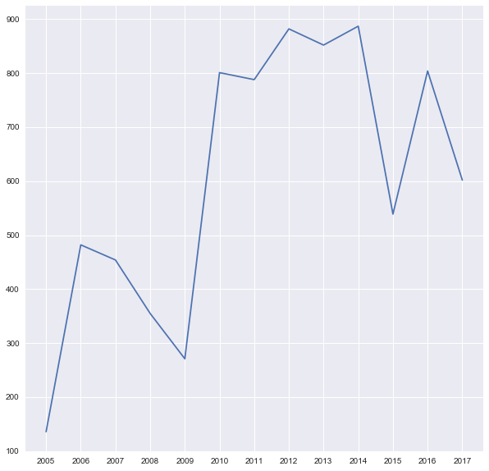
Final Analysis and Insights Organizations, Data Breaches and Time 2005-2017
Is there any trend in data breaches over time (between 2005 and 2017)?
It appears that the trend is showing an increase over time.

Slide 64
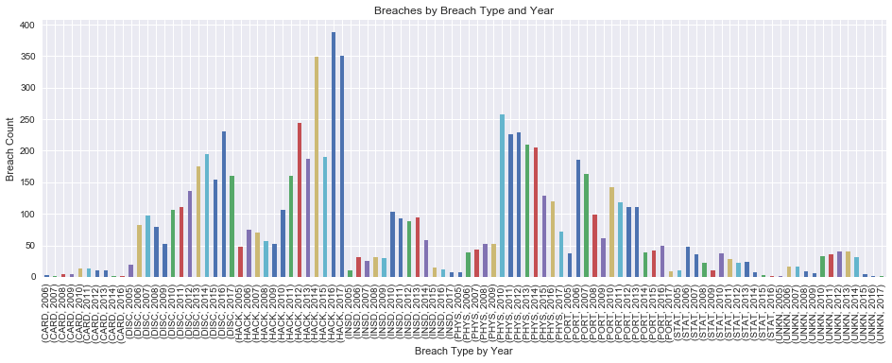
Final Analysis and Insights Organizations, Data Breaches and Time 2005-2017
This graph will be used to answer the next group of questions:

Slide 65
Final Analysis and Insights Organizations, Data Breaches and Time 2005-2017
Any relationship between time and data breach type?
Yes, there are different types of breaches and associated organizations that are more or less popular depending on the year.
Any data breach type increasing over time?
Hacking, Disclosure and Physical (although dropped considerably in 2017), are showing increases over time.
Any data breach type declining over time?
All breach types showed a decline from 2016 to 2017 probably due to improvement in security technology. Credit Card, Insider, Stationary computer loss and portable device breaches showed a decline over time.
(refer to graph on previous slide)

Slide 66
Final Analysis and Insights Organizations, Data Breaches and Time 2005-2017
Multiple data breaches (repeating incidents) –
Organizations that have experienced repeated incidents
How many organizations (“company”) have multiple data breaches (more than one data breach between 2005 and 2017)?
Approximately 802 ‘True’ (6718 unique - 5916 not > 1)
df_time.groupby('Company').size() > 1 = count 6718
unique 2
top False
freq 5916

Slide 67
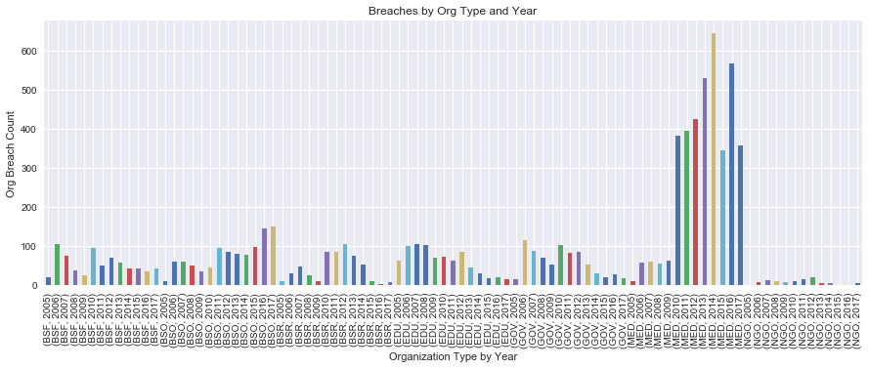
Final Analysis and Insights - Organizations, Data Breaches , Time Multiple data breaches – Organizations that have experienced repeated incidents
What organization types are more likely to experience multiple data breaches (more than one data breach between 2005 and 2017) than other organization types?
The organization type that is more likely to be hit with a data breach is clearly a Medical organization.

Slide 68
Final Analysis and Insights - Statistical Analysis
Request to test two null hypotheses
First hypothesis - “two data breach types—DISC and HACK—are equal in the harm caused to organizations in terms of records affected (“Total_Recs”)”.
Second hypothesis - “all data breach types are equal in the harm caused to organizations in terms of records affected (“Total_Recs”)”.
Ran tests for normal distribution:
NormaltestResult(statistic=10961.939152487257, pvalue=0.0) NormaltestResult(statistic=26402.890893042619, pvalue=0.0) NormaltestResult(statistic=2040.0978912919225, pvalue=0.0)
In all three tests for a normal distribution, the pvalue = 0.0. This means we reject both null hypothesis.

Slide 69
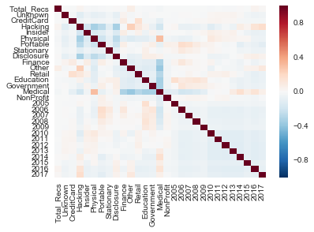
Final Analysis and Insights - Statistical Analysis
Request to test two null hypotheses
Checking correlation of all data items:
There is a significant negative correlation between Hacking and Disclosure at - 0.334222, but there is no correlation between Hacking and Total Records or Disclosure and Total Records

Slide 70
Final Analysis and Insights – Overall Findings
Summary of Overall Findings and Technical and Managerial Implications
Using Random Forest, Topic Modeling and statistical analysis, determined that hacking has become a major problem in the healthcare arena. The type and amount of data held in that organization type makes it a favorite target of hackers. HIPAA requirements for data privacy also make healthcare facilities a target.
Physical loss is growing at a faster pace and has become second in number of breach occurrences. It can cause unintentional disclosure depending what is contained in the documents. It is surprising that it is increasing, given that much reporting is digital, not hard-copy printouts. Employees need to be aware of what is contained in printed out emails, spreadsheets and screen prints and trained to dispose of unneeded documents in secure containers (for shredding). As data privacy has growing importance, employees, employers and students may be ignorant as to leaving paper, film, flash or USB drives with private data lying around.

Slide 71
Final Analysis and Insights – Overall Findings
Summary of Overall Findings and Technical and Managerial Implications
Unintentional Disclosure is also increasing in importance. Making sure that the correct customer information, including name, address, phone (mobile and landline) and email address are stored securely in the data repositories and kept in sync and current. Systems have to be designed to ensure this is the case. Modernization has allowed redesign of old legacy systems to accommodate the newer technology.
Access to data must be secure. As hackers have been very clever in breaking into databases, passwords have become more complex with multi-step logins required for individual access. These additional security measures have become much more common in the last five years. This would account for an overall decrease of breaches from 2016 to 2017, much lower than 2014. Another area that needs attention is to remove access to systems when a student or employee is no longer a part of an organization.
As more and more companies moved towards cloud-based systems away from mainframe batch systems beginning around 2009, security did not keep up with a peak occurring in 2014. As more companies are modernizing and going real time, security has to be enhanced. That is the trend.
Roughly 10% of the companies in the provided dataset have experienced multiple breach incidents.
California and Texas and New York consistently have the most breaches. The size of a company may be a factor. Headquarter locations and technology centers may be a factor in why certain locations have higher incidences of data breaches.

Slide 72
Final Analysis and Insights – Overall Findings
Summary of Overall Findings and Technical and Managerial Implications
Business centers are shifting in terms of location. The ‘cloud’ has enabled business to be located in less populated business centers. That may account for the increase in ‘other’ businesses’ data breach occurrences. The amount of secure data held by a specific organization type may be a factor in data breach occurrences. Another factor is that many smaller organizations are ‘going online’ and able to grow due to technological advances.

Slide 73
Final Analysis and Insights – Overall Findings
Recommendation
The trend is that incidences of data breaches is increasing, even though there was a decrease from 2016 to 2017. Different types of breaches can be in vogue depending on the technology and whether security measures have kept up. That will shift from year to year. Unfortunately, a new method of gaining access to data may be developed before the security has a chance to deal with it. The recommendation is to be proactive in developing security before the breach happens.
Individuals need to be aware of what types of data is contained in a small piece of paper or even on their cell phones. Unneeded private data on physical media needs to be disposed of in secure containers for shredding. This requires the use of the secure trash container and training.

